Slide 1
Camino Real Regional Utility Authority North
Wastewater Collection System IMPROVEMENTS
Public Meeting: September 8, 2021

Slide 2
Project Purpose and Need
The Camino Real Regional Utility Authority (CRRUA) proposes to rehabilitate and upgrade portions of its existing wastewater collection system in order to:
Continue to meet existing health and sanitation needs of the CRRUA service area;
Replace aging and deteriorated infrastructure; and
Meet the future wastewater collection system needs for the existing and committed customers in Sunland Park and surrounding vicinity.

Slide 3
Project ELEMENTS:
McNutt Gravity Sewer Line Replacement –
An existing 10-inch gravity sewer line extending parallel to McNutt Road between Airport Road and the North WWTP would be replaced with an 18-inch gravity pipeline (approximately 5,100 linear feet).
Manholes along this corridor would also be replaced, as the existing manholes are corroding and posing safety hazards (Figures 1 and 2).

Slide 4
Project ELEMENTS Cont.
Dagger Lift Station Replacement –
Existing Dagger lift station is in poor condition, is an extreme hazard to operations staff, and will require full replacement.
The existing force main will be replaced with a new force main comprised of conventional materials sized for proper flow rates (Figure 1).

Slide 5
Project ELEMENTS Cont.
South Lift Station Replacement –
The existing South lift station has deteriorated to a point where it needs full replacement.
The lift station would be replaced with a new lift station with the capacity to receive flows from both the local gravity collection system as well as any excess flows routed from Viewpointe lift station #1.
The new South lift station would be able to pump these flows through the existing 10-inch force main pipeline to Sunland Park WWTP (Figure 2).

Slide 6
Project ELEMENTS Cont.
Lift Station #7 Force Main Replacement –
Lift Station #7 force main along McNutt Road currently exceeds the maximum velocity and pipe pressure rating of the existing pipeline.
Several sections of the pipeline have failed and caused leaks to occur.
This task will fully replace this forcemain of approximately 5,300 linear feet of pipeline (Figure 1).

Slide 7
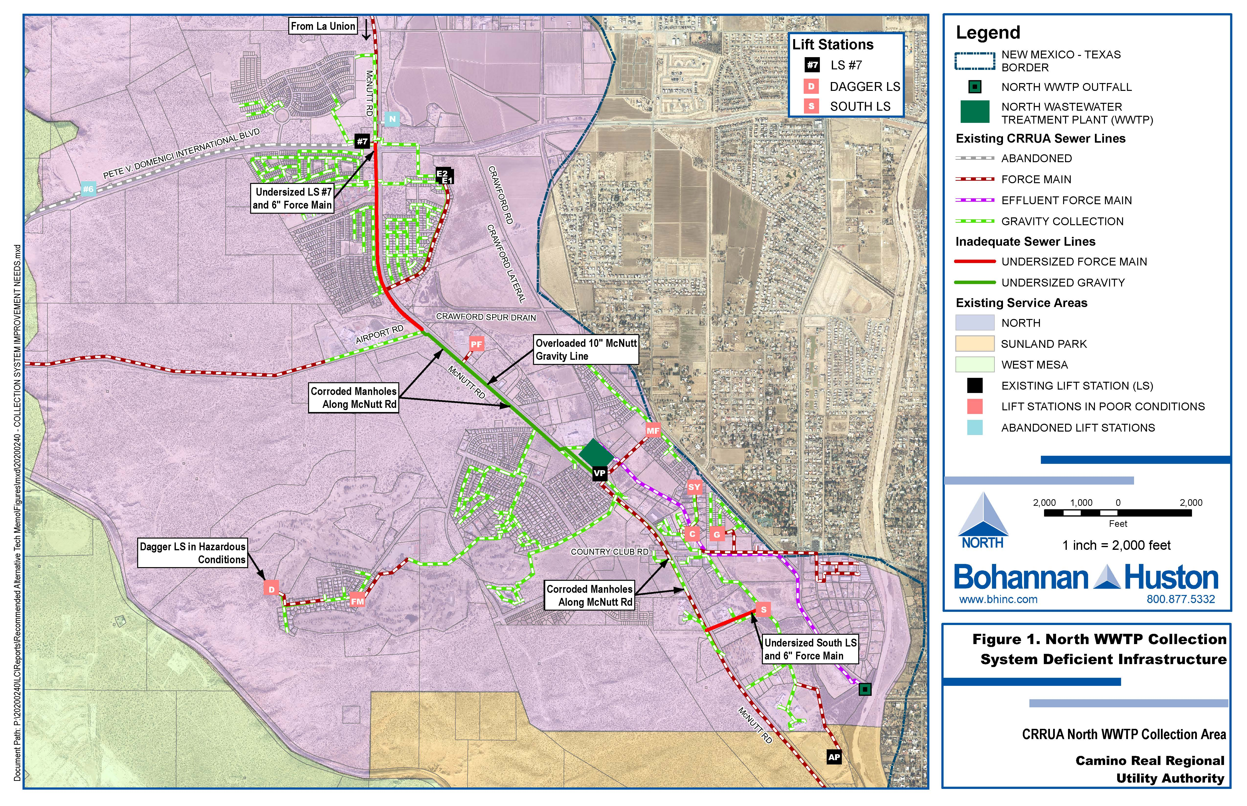
Project Figures

Slide 8
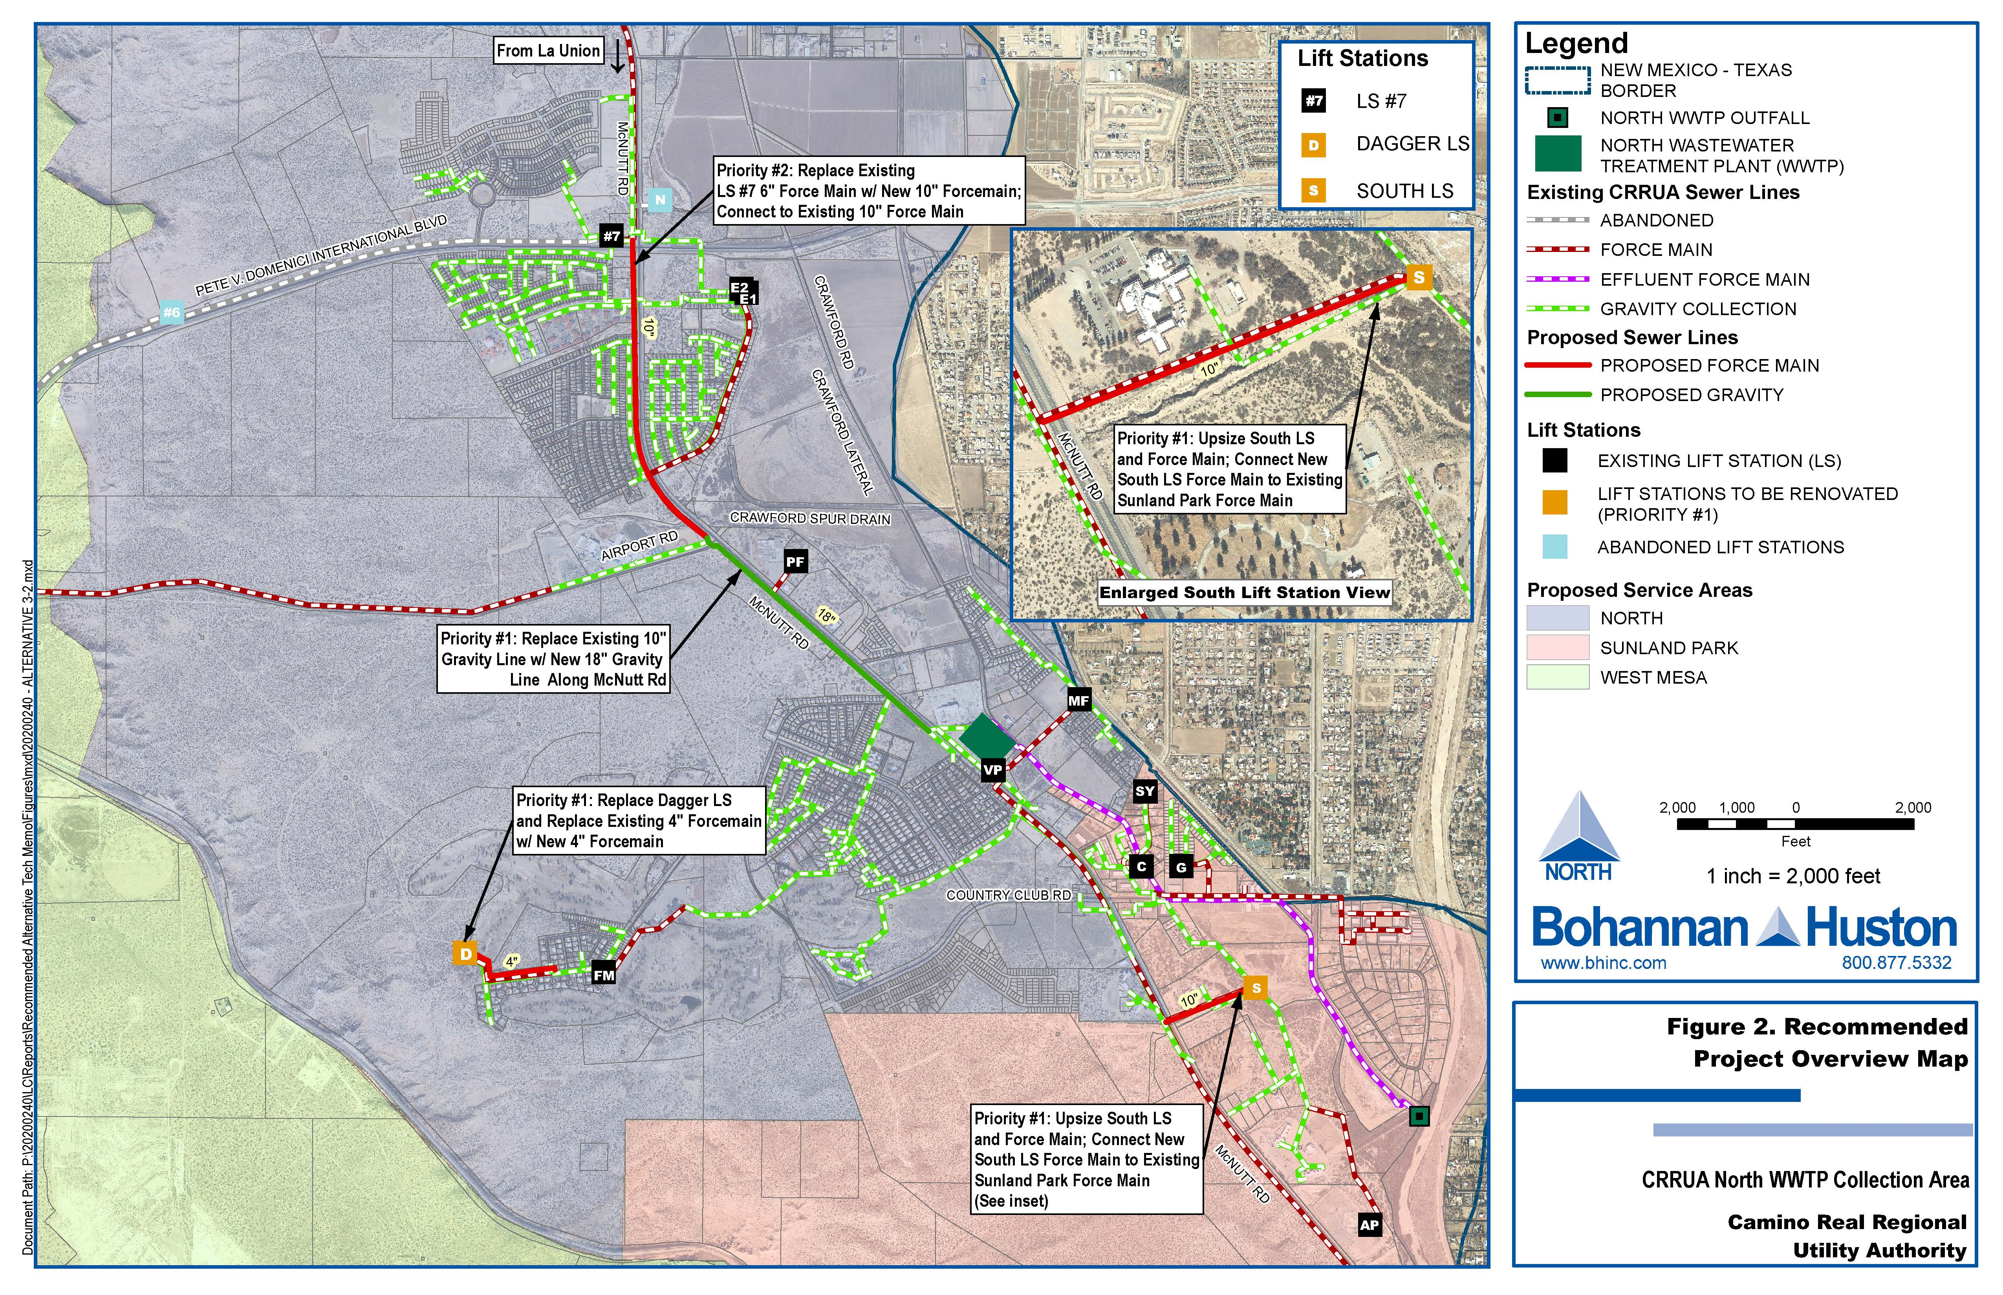
Project Figures

Slide 9
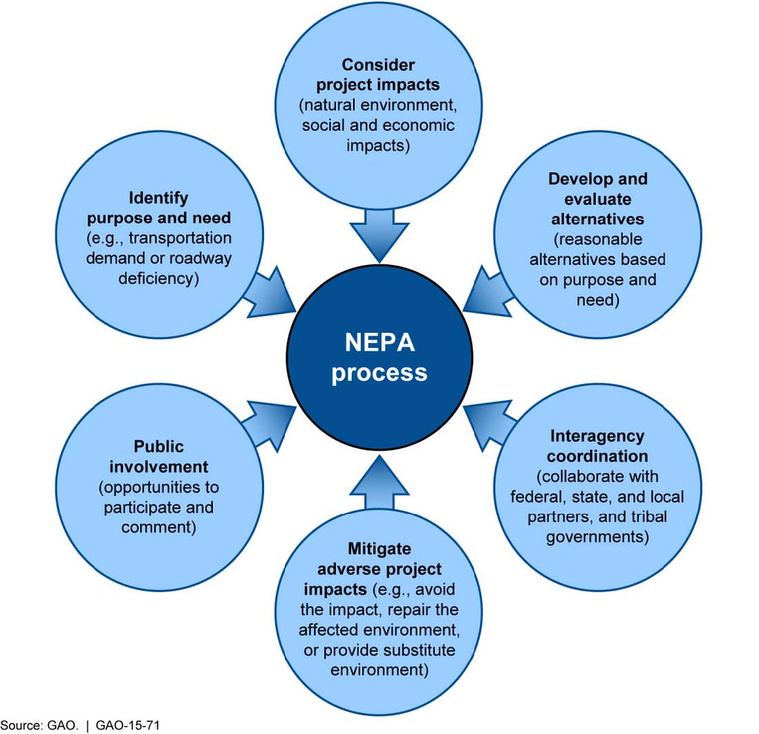
Environmental Review Process
Notes:
I am going to briefly outline the environmental review process, why we do it, and why we think it is important to have public meetings and involvement.
NEPA is the National environmental protection act – Law passed by congress in 1968 to promote the enhancement of the environment.
The law mandates that line offices and decision makers solicit and utilize public involvement and comment to inform the development of actions that may affect the community
Public comments help create a more complete project understanding and allow for a relationship building process between decision makers and the public.
As local residents in, or near the project area, you posses valuable insight to the project area and day to day limitations and situations we may not be aware of.
If you look at this slide you can see the various spheres of influence that drive the overall NEPA process.
We started this presentation tonight with the purpose and need of the project – rehabilitate and upgrade portions of its existing wastewater collection system in order to: Continue to meet existing health and sanitation needs, replace aging and deteriorated infrastructure; and meet future wastewater collection system needs.
We move to the Project impacts where we do analysis on the socio-economic impacts, impacts to the natural and built environment, are their traffic concerns, ingress, egress, will certain businesses be adversely or positively impacted?
As we are examining the impacts we begin to develop and evaluate alternatives – is this the best placement, material, timing, etc for this project?
This was largely done by BHI during the preliminary engineering report in March 2021
Once the project is taking shape Interagency coordination will take place to ensure there are no conflicts with federal, state, local, or tribal governments.
At a similar time we will begin to consult with the Public for involvement. Much like the interagency coordination, we want to know if the public has issues, conflicts, positive, or negative views. Did we create adequate alternatives? Did we consider the correct project impacts?
When all of that is synthesized, we make recommendations to avoid, reduce, or mitigate issues that the project may create.
This process guides the NEPA process and helps ensure that the project has a greater likelihood for success from the local community, partners, and collaborating agencies.

Slide 10
Biologic & Cultural Assessment –
CRRUA Survey
Biological and Cultural surveys were not required based on the scope of the project
Armchair review of project area was conducted for Environmental Information Document
The project would be constructed entirely on previously disturbed land and falls within existing utility easements, lands owned by the New Mexico Department of Transportation (NMDOT), Doña Ana County, and some privately-owned land

Slide 11
Biologic &Cultural Assessment – CRRUA
No floodplains would be impacted
No wetlands would be impacts
No critical habitat will be impacted
No federal, state, or county listed species will be effected
No significant impacts to cultural resources or historic properties are anticipated
Entire project area falls within heavily developed environment

Slide 12
Project documentation status – CRRUA
Environmental Information Document sent for agency consultation 15 July 2021
Public meeting held 8 September 2021
  Zoom poll about project components (Available now)
  Email comments to: jrichards@epsilonsystems.com Deadline for comments is: 8 October 2021

Slide 13
schedule
Design Phase – November 2021 through December 2022
Permit Acquisition – January 2023 through April 2023
Construction Phase – May 2023 – June 2024
Final Completion – Estimated to be July 2024

Slide 14
Public Questions & comments
  Zoom poll about project components (Available in the chat in English and Español)
  Email comments to: jrichards@epsilonsystems.com
    Deadline for comments is: October 8th

